Slide 1

Busgazer
Intelligent Transportation, Smarter City

Slide 2


Slide 3
Complexity and Uncertainty
in Transportation Systems

Slide 4
Complexity and Uncertainty
in Transportation Systems
Realtime Transportation Search Engine

Slide 5
Realtime
Data

Slide 6
Realtime
Data
Collection

Slide 7
Processing
Realtime
Data
Collection

Slide 8
Processing
Realtime
Data
Collection
Presentation

Slide 9
Processing
Realtime
Data
Collection
Presentation
Computing Infrastructure

Slide 10
Processing
Artificial Intelligence
Realtime
Data
Collection
Presentation
Computing Infrastructure

Slide 11
Processing
Human Computer
Interaction (HCI)
Artificial Intelligence
Realtime
Data
Collection
Presentation
Computing Infrastructure

Slide 12
Human Computer
Interaction (HCI)
Artificial Intelligence
Computing Infrastructure

Slide 13
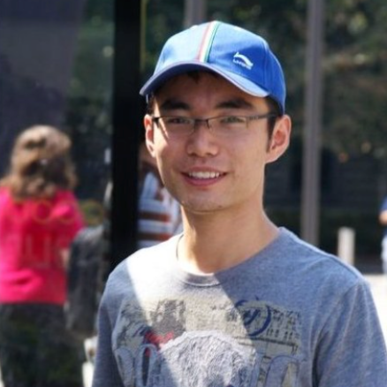
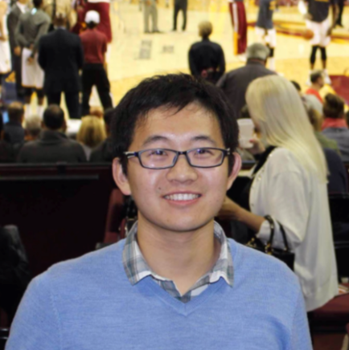
Human Computer
Interaction (HCI)
Artificial Intelligence
Jiannan Ouyang
Team Lead
Ph.D. Student
Operating System
Xiaolong Cui
Ph.D. Student
Distributed System
Computing Infrastructure

Slide 14
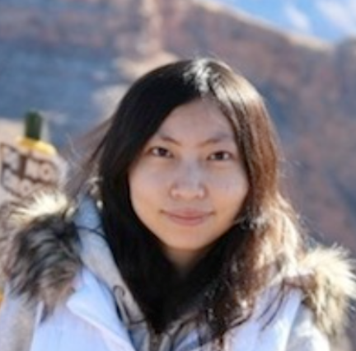
Lingjia Deng
Ph.D. Student
Artificial Intelligence
Human Computer
Interaction (HCI)
Artificial Intelligence
Jiannan Ouyang
Team Lead
Ph.D. Student
Operating System
Xiaolong Cui
Ph.D. Student
Distributed System
Computing Infrastructure

Slide 15
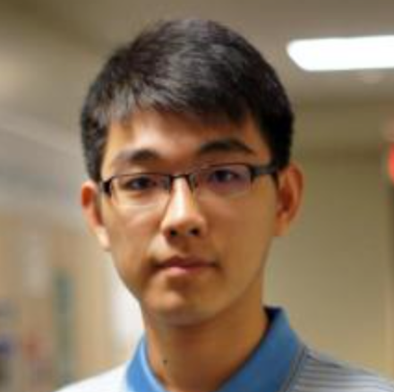
Lingjia Deng
Ph.D. Student
Artificial Intelligence
Xiangmin Fan
Ph.D. Student
HCI
Human Computer
Interaction (HCI)
Artificial Intelligence
Jiannan Ouyang
Team Lead
Ph.D. Student
Operating System
Xiaolong Cui
Ph.D. Student
Distributed System
Computing Infrastructure

Slide 16
Lingjia Deng
Ph.D. Student
Artificial Intelligence
Xiangmin Fan
Ph.D. Student
HCI
The Dream Team
Jiannan Ouyang
Team Lead
Ph.D. Student
Operating System
Xiaolong Cui
Ph.D. Student
Distributed System

Slide 17
Apr. 2015
Busgazer App: 3500+ Downloads

Slide 18
Apr. 2015
Busgazer App: 3500+ Downloads
Dec. 2015
Enhanced Vehicle Arrival Prediction (<10s)

Slide 19
Apr. 2015
Busgazer App: 3500+ Downloads
Dec. 2015
Enhanced Vehicle Arrival Prediction (<10s)
Apr. 2016
Realtime Transportation Search Engine

Slide 20
Apr. 2015
Busgazer App: 3500+ Downloads
Dec. 2015
Enhanced Vehicle Arrival Prediction (<10s)
Apr. 2016
Realtime Transportation Search Engine
Dec. 2016
Realtime Parking Solution

Slide 21
104.19B
45.05B
Global Smart Transportation Market
Source: MarketsandMarkets, March 2014.

Slide 22
104.19B
45.05B
Global Smart Transportation Market
Source: MarketsandMarkets, March 2014.

Slide 23
18.3% CAGR
104.19B
45.05B
Global Smart Transportation Market
Source: MarketsandMarkets, March 2014.

Slide 24
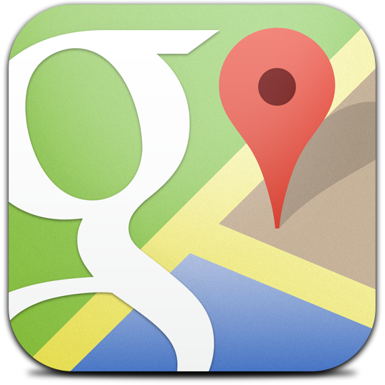
Google Map

Slide 25
Google Map
Bus
Transit
Moovit
Tiramisu
Parking
ParkPGH
Smarking*
Search
Mozio*
Flitways*

Slide 26
Freemium

Slide 27
Freemium
Free
Search
Booking
Parking

Slide 28
Freemium
Free
Search
Booking
Parking
Premium
No Ads
Improved Accuracy

Slide 29
+
Freemium
In-App Ads
Free
Search
Booking
Parking
Premium
No Ads
Improved Accuracy

Slide 30
+
Freemium
In-App Ads
Free
Search
Booking
Parking
Premium
No Ads
Improved Accuracy
Personalized
Location-Based
Realtime

Slide 31
Processing
Realtime
Data
Collection
Presentation

Slide 32


Busgazer
Intelligent Transportation, Smarter City.

